Slide 1
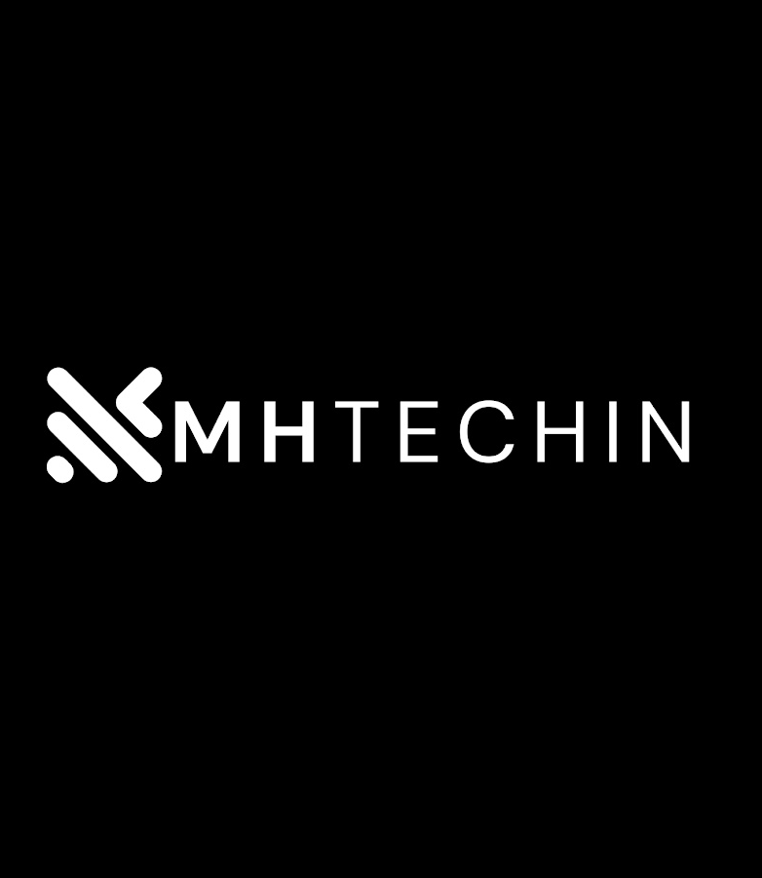


MEAN & MERN
Presented by:
Jeevan H T

Slide 2
JavaScript Stacks :
MEAN Stack :
The MEAN stack consists of MongoDB, Express.js, Angular, and Node.js. It offers a full-stack JavaScript solution for building web applications. MongoDB provides a flexible NoSQL database, Express.js handles server-side operations, Angular facilitates client-side development, and Node.js powers the server.
MERN Stack :
The MERN stack includes MongoDB, Express.js, React, and Node.js. It is similar to MEAN but replaces Angular with React, a popular JavaScript library for building user interfaces.

Slide 3
MEAN Stack:
MongoDB :
MongoDB is a NoSQL database that offers scalability, flexibility, and easy integration with Node.js.
Express.js:
Express.js is a lightweight web application framework for Node.js, providing a robust set of features for building server-side applications.
Angular :
Angular is a powerful JavaScript framework for building dynamic web applications, providing a comprehensive set of tools and features for client side development.
Node.js:
A JavaScript runtime that allows you to run JavaScript on the server, enabling you to build full-stack applications using a single programming language.

Slide 4
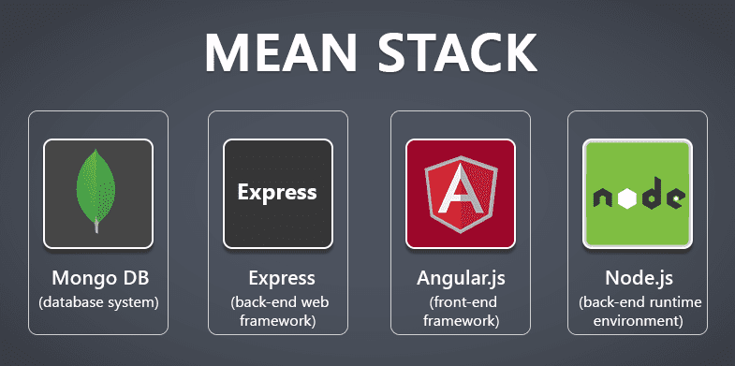

Slide 5
MERN Stack:
MongoDB:
MongoDB remains the same in the MERN stack, offering the same benefits as in the MEAN stack.
Express.js :
Express.js, like in the MEAN stack, provides a lightweight web application framework for server-side operations.
React :
React is a JavaScript library for building user interfaces, offering a component based approach and high performance.
Node.js :
A JavaScript runtime that allows you to execute server-side code.

Slide 6
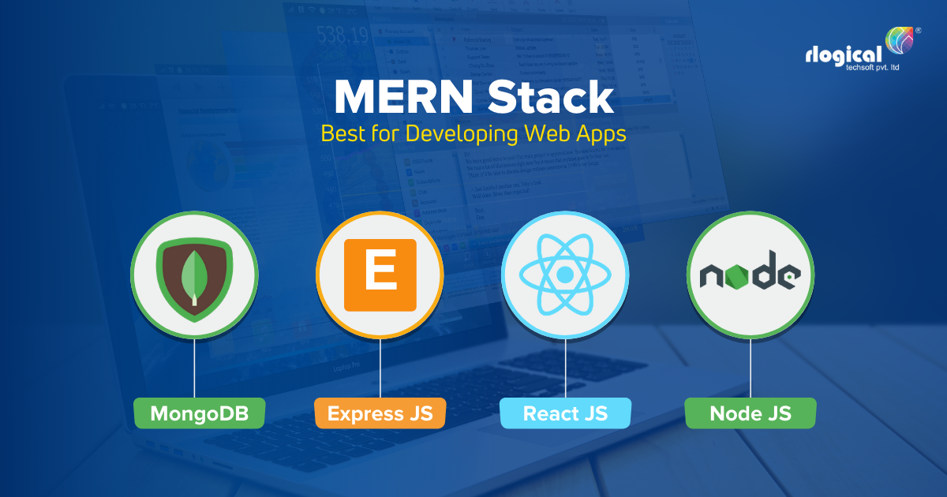

Slide 7
Similarities:
Both MEAN and MERN stacks share several similarities :
Use JavaScript for both server-side and client-side development.
Utilize MongoDB as the NoSQL database.
Rely on Express.js for server-side operations.
Enable building scalable and efficient web applications.

Slide 8
Differences :
While MEAN and MERN stacks have similarities, they also have some key differences:
MEAN uses Angular for client-side development, while MERN uses React.
Angular offers a comprehensive framework, while React focuses on the view layer.
React's virtual DOM provides efficient rendering, while Angular's two-way data binding simplifies development.

Slide 9
Advantages of MEAN :
MEAN stack offers several advantages:
Angular's comprehensive framework provides a structured development approach.
Two-way data binding in Angular simplifies handling of data between components.
Angular has a large and active community, offering extensive resources and support.

Slide 10
Advantages of MERN :
MERN stack brings its own set of advantages:
React's component-based architecture enables reusability and modularity.
React's virtual DOM ensures efficient rendering and improved performance.
React has gained popularity and has a vibrant ecosystem with numerous libraries and tools.

Slide 11
Disadvantages:
Both MEAN and MERN stacks have some limitations:
Learning curve: Both Angular and React have their own learning curves, which may require time and effort to master.
Complexity: MEAN and MERN stacks may introduce complexity due to the combination of multiple technologies.
Performance: While React's virtual DOM improves performance, Angular's two-way data binding can impact performance in certain scenarios.

Slide 12
Conclusion :
In conclusion, both MEAN and MERN stacks offer powerful JavaScript-based solutions for building web applications.
The choice between them depends on your specific project requirements and team expertise. Consider the advantages, disadvantages, and your familiarity with Angular or React to make an informed decision. Whichever stack you choose, you'll have access to a rich ecosystem and vibrant communities to support your development journey.

Slide 13

Thank you

